Slide 1

Candy Production Analysis
Present by
Yifan Gao, Stephanie Liu,
Qi Ma, Ruoyun Zhang

Slide 2






AGENDA
01
Project Goal and Business Use Case
02
Data Introduction And Visualization
03
Data Exploration
04
Data Modeling
05
Evaluation and Results
06
Conclusion and Future Work

Slide 3

Project Goal And Business Use Case
Background and Project Goal
With increasing consumer spending and growing urbanization, there arises a huge demand for consumer goods, especially the candy market in the country. The aim of this project is to understand the behavior of U.S. candy market in the past 50 years, such as overall trend, seasonality and cyclicity
Business Use Case
The conclusion of our model can be used to understand the supply and demand for candy and for companies to make offering or buying decisions.
Project Goal and Use Case - Data Intro-Data Exploration-Data Modeling-Result and Evaluation-Conclusion and Future Work

Slide 4
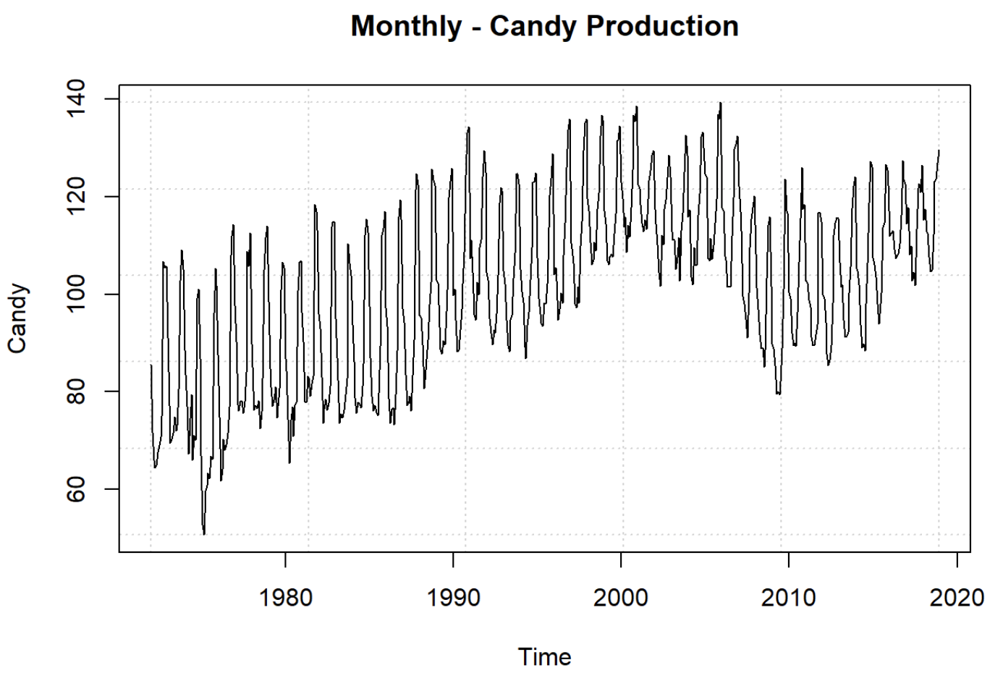
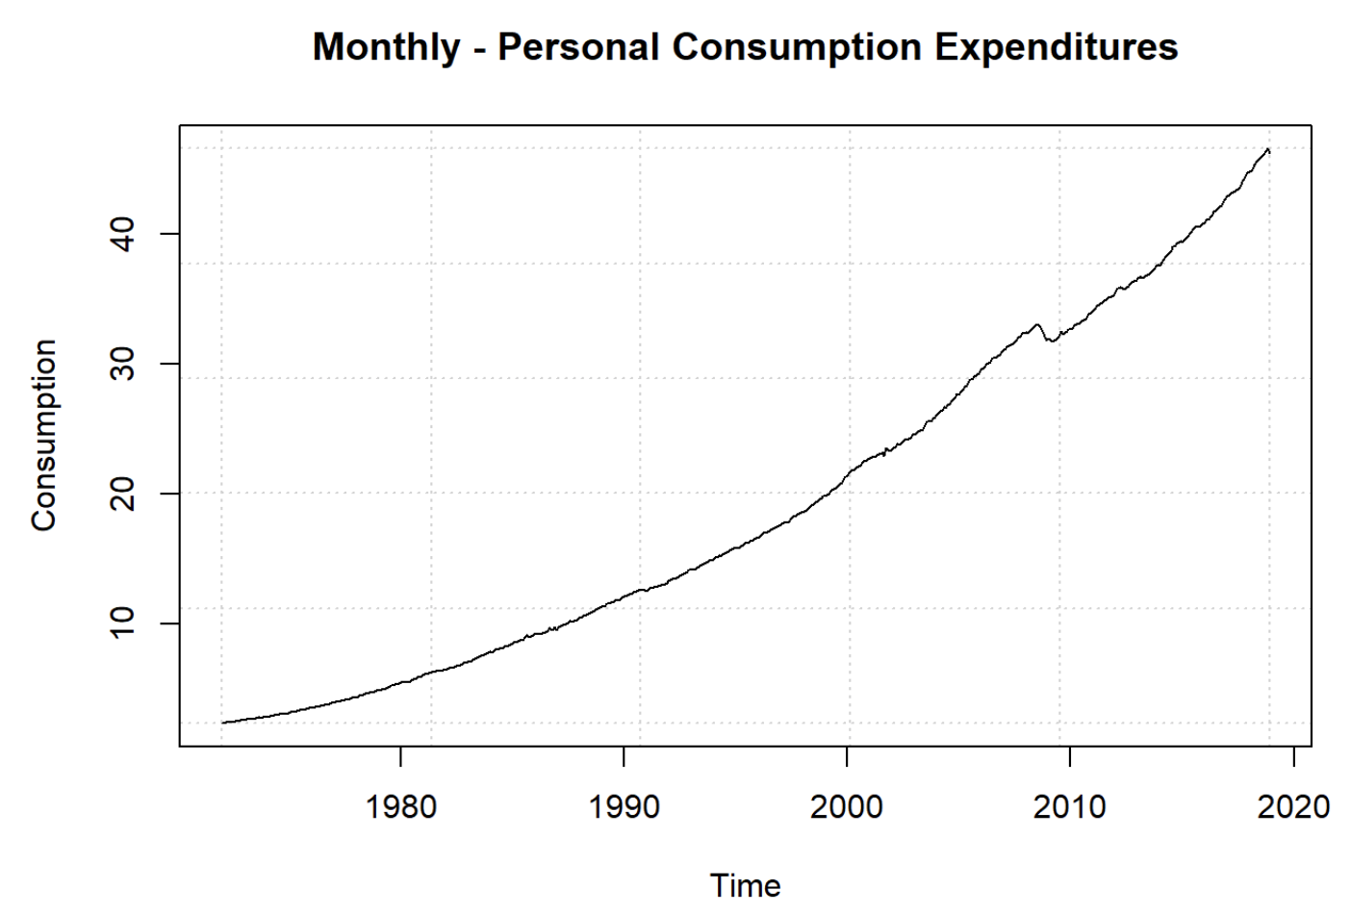
Data Introduction and Visualization
Our dataset tracks the monthly candy production in United States from 1972 to 2018 (source: https://www.kaggle.com/sachinkun21/us-monthly-candy-production-datatime-series). We also use personal consumption expenditures in United States as an exogenous variable (source: https://fred.stlouisfed.org/series/PCE). We believe these two variables are positively correlated.
We split our data in two train dataset (1972.1 -2017.12) and test dataset (2018.1-2018.12).
Project Goal and Use Case - Data Intro-Data Exploration-Data Modeling-Result and Evaluation-Conclusion and Future Work

Slide 5
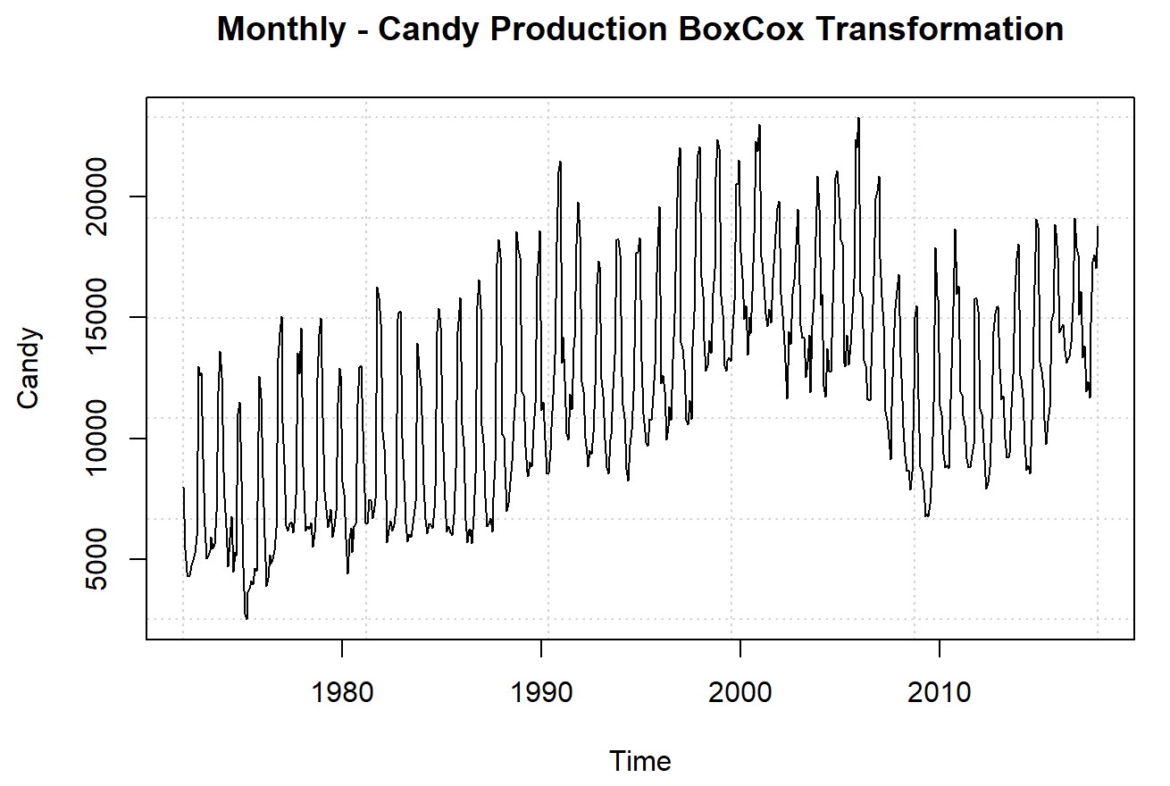
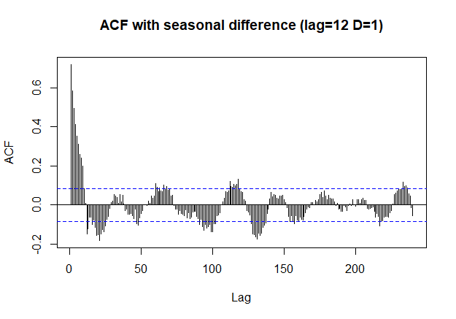
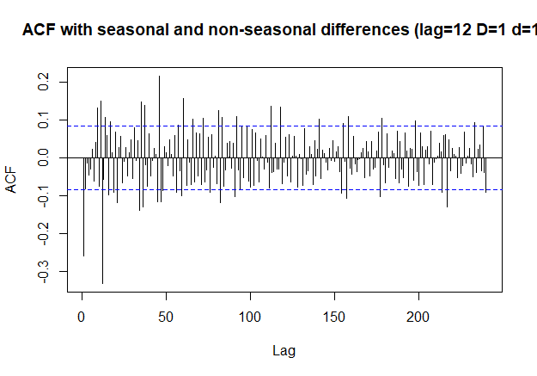
Data Exploration – Candy Production
Box Cox Transformation
First Order Differencing
Second Order Differencing
Box-Cox transformation is necessary because there’s seasonality and the variance is unstable. After Box-Cox the variance is stabilized.
We need to take first order seasonal differencing because we can still see trend and seasonality.
We apply non-seasonal differencing on seasonal differencing because there’s still some seasonality in first order ACF plot. After that, most lags are within the threshold range.
Project Goal and Use Case - Data Intro- Data Exploration -Data Modeling-Result and Evaluation-Conclusion and Future Work
Notes:
lambda

Slide 6
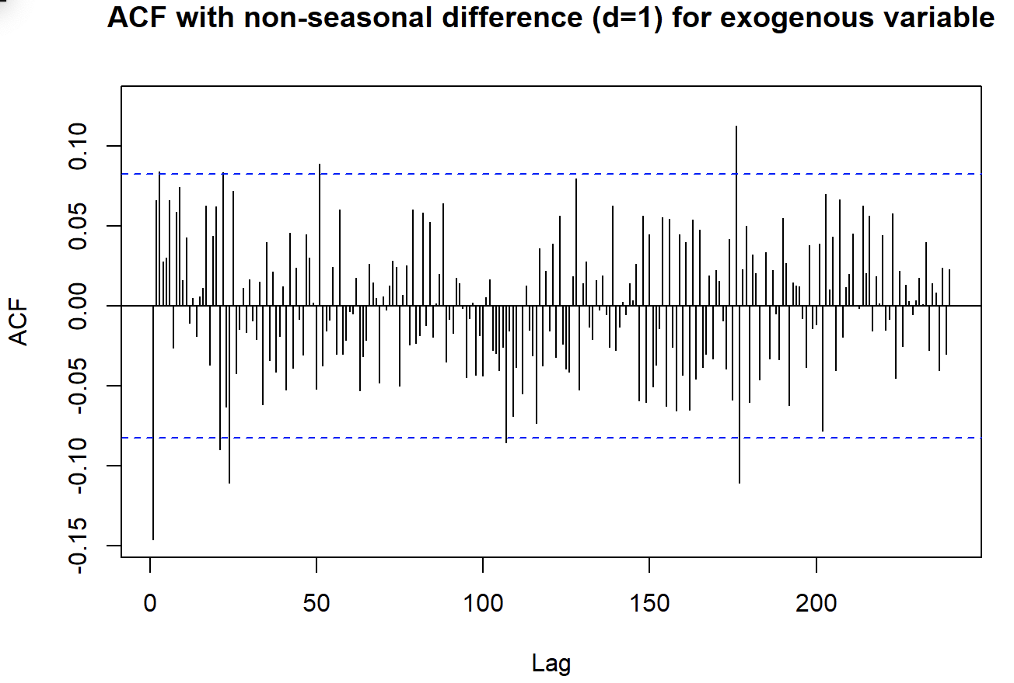
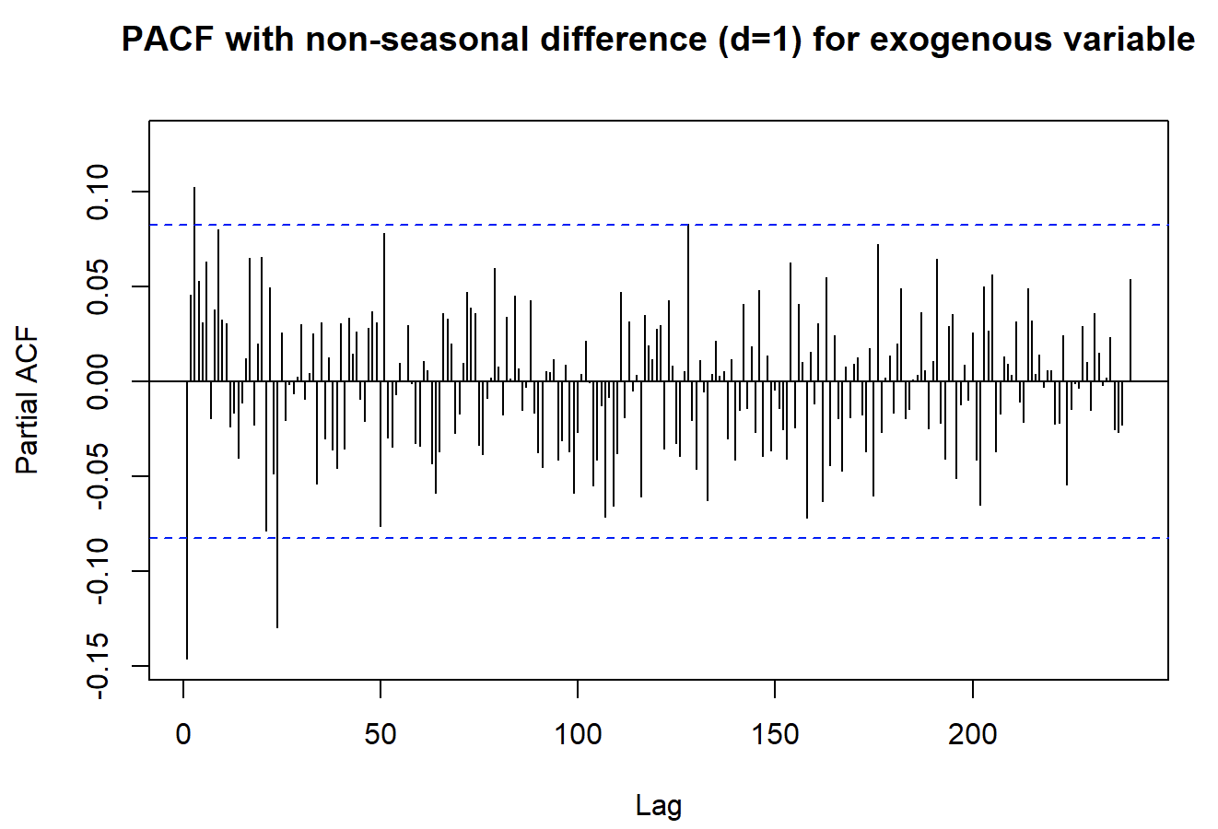
Data Exploration – Exogenous Variable
Box-Cox Transformation
1
Our goal is to ensure that both the candy production and the exogenous variable are stationary. We apply Box-Cox transformation since the variance for exogenous is not stable.
Apply Non-seasonal Difference
2
After Box-Cox transformation, we take a non-seasonal difference on the exogenous variable since there is no seasonal pattern on this dataset
Project Goal and Use Case - Data Intro - Data Exploration -Data Modeling-Result and Evaluation-Conclusion and Future Work
Notes:
lambda

Slide 7
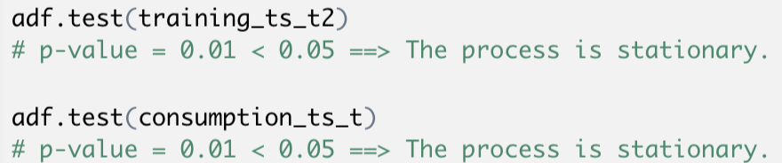
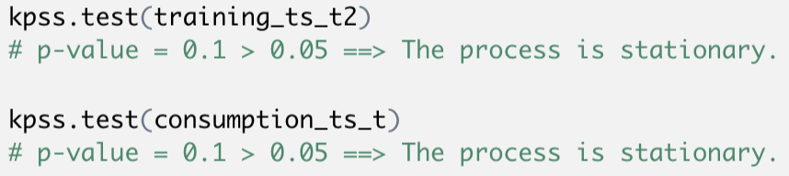
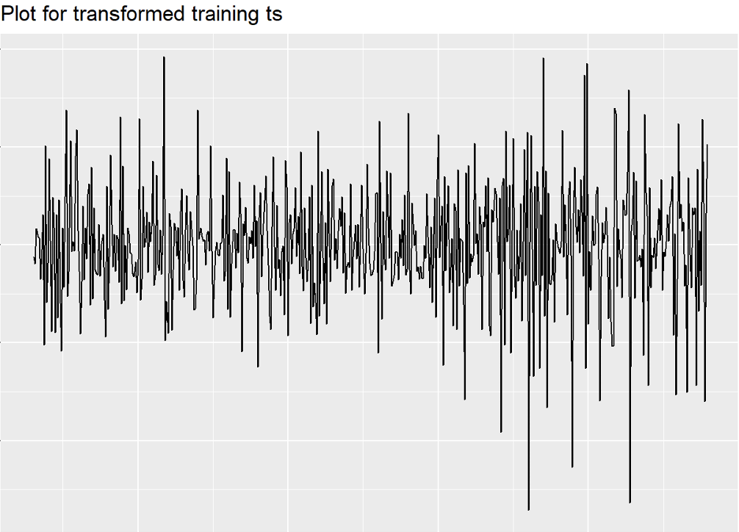
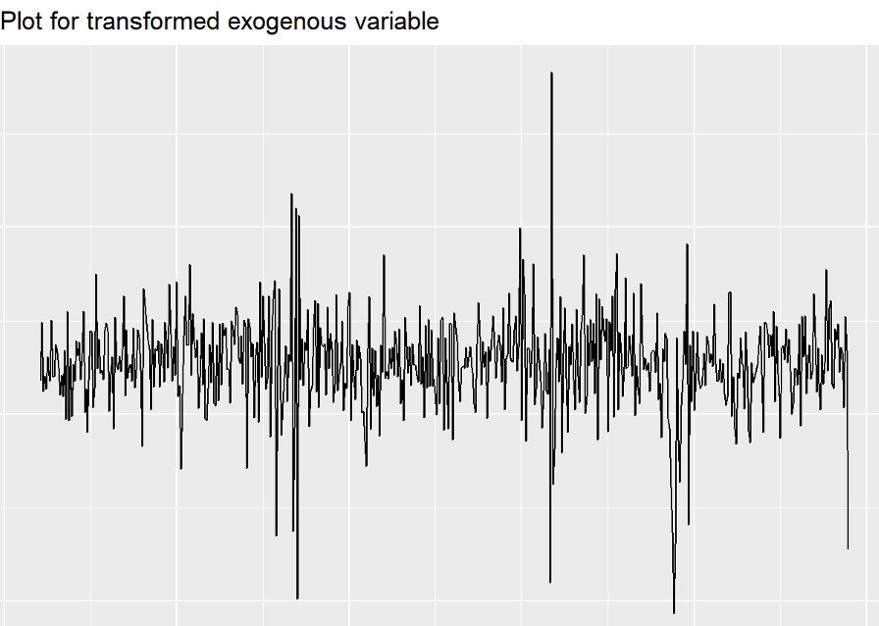
Test for stationarity
ADF test
KPSS test
Project Goal and Use Case - Data Intro - Data Exploration -Data Modeling-Result and Evaluation-Conclusion and Future Work

Slide 8
Data Modeling Overview
ARIMA Model
Linear regression
Regression Model With ARIMA Errors
VAR Model
TBATS Model
AFRIMA Model
ETS Model
Intervention Model
Fourier terms with ARIMA error
Project Goal and Use Case - Data Intro - Data Exploration -Data Modeling -Result and Evaluation-Conclusion and Future Work

Slide 9
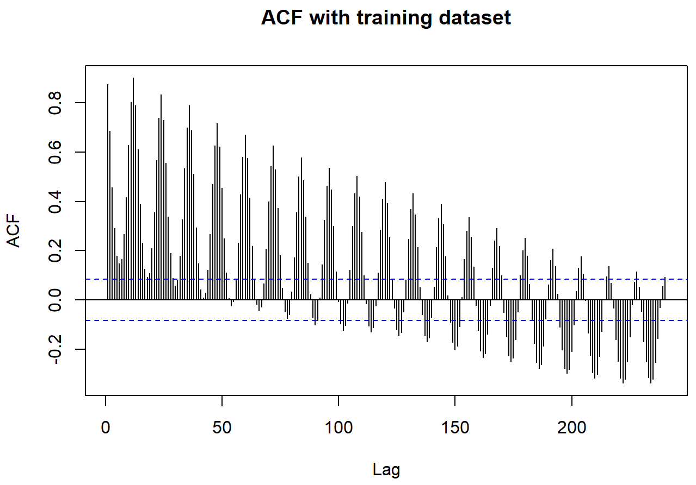
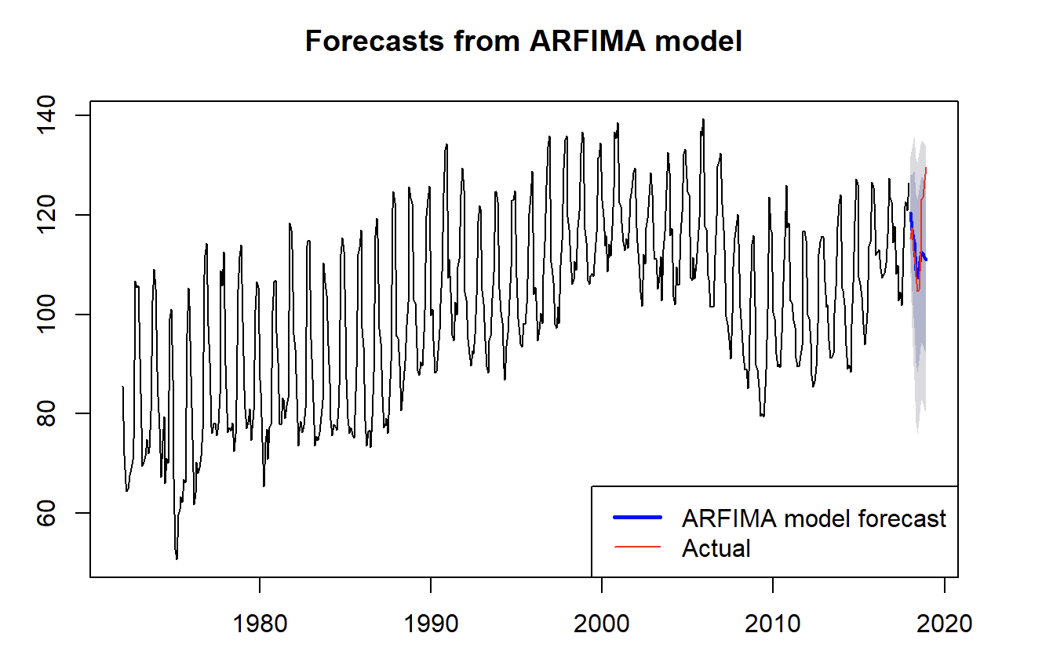

ARFIMA
AFRIMA
There seems to be a long memory issue as the ACF delays slowly
d = 0.482
Residuals do not resemble white noise according to Ljung-Box test
Forecast period = 12
Project Goal and Use Case - Data Intro - Data Exploration -Data Modeling -Result and Evaluation-Conclusion and Future Work
Notes:
ARFIMA is useful when there is not high autocorrelations. From our ACF the autocorrelations are high in the beginning which suggests ARFIMA might not be good model.

Slide 10
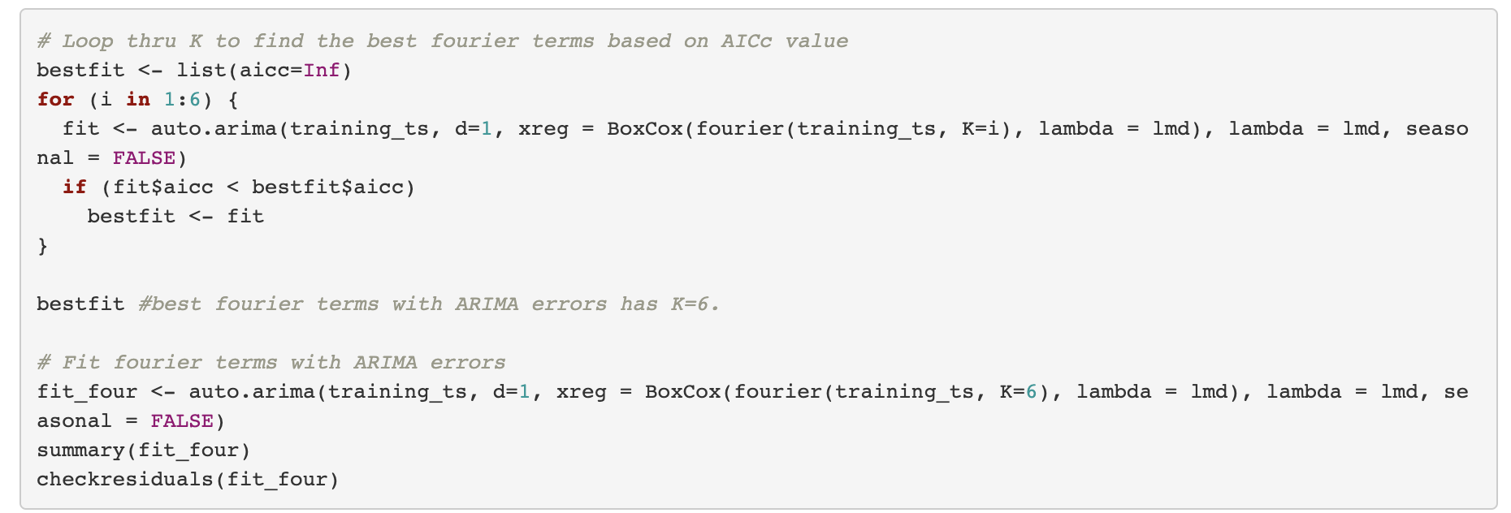
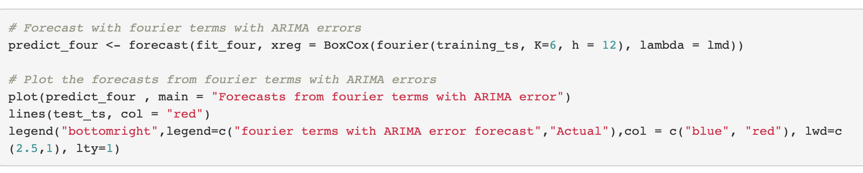
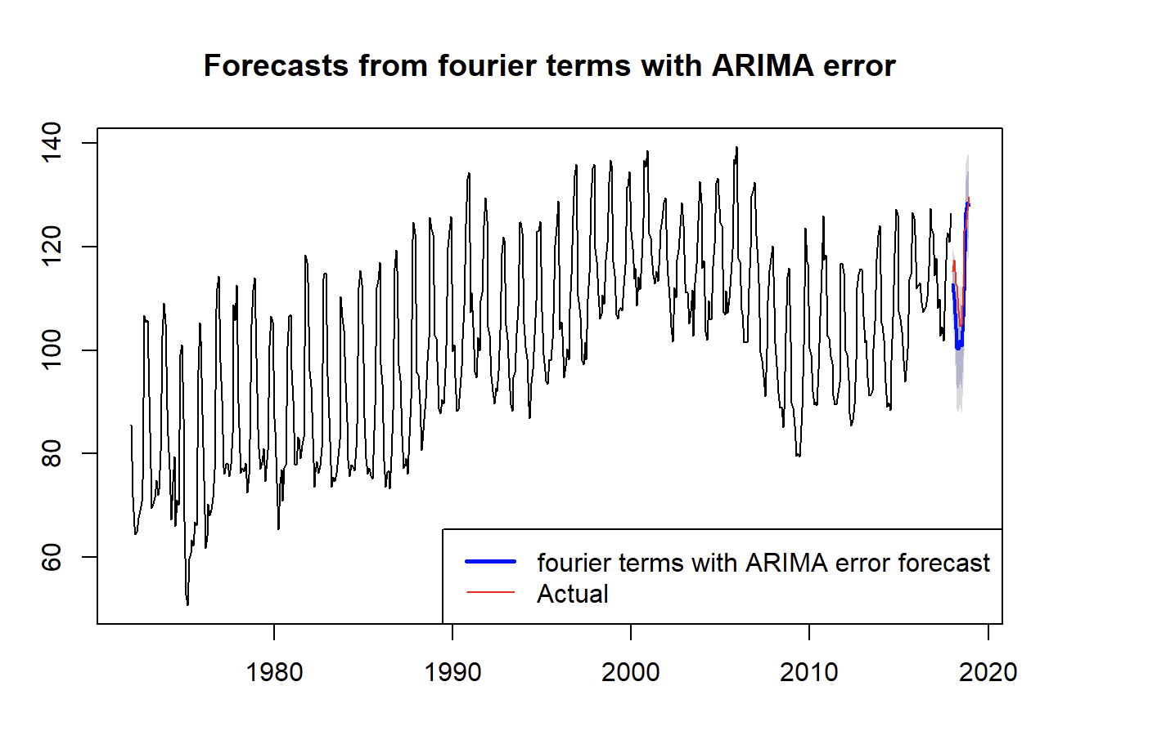
FOURIER
Fourier model with Arima error
Create a grid search function to find best K value based on AICc
Residuals do not resemble white noise according to Ljung-Box test
Some coefficients are not significant which indicates the model does not fit well
Forecast for Fourier terms with ARIMA errors model
Project Goal and Use Case - Data Intro - Data Exploration -Data Modeling -Result and Evaluation-Conclusion and Future Work

Slide 11
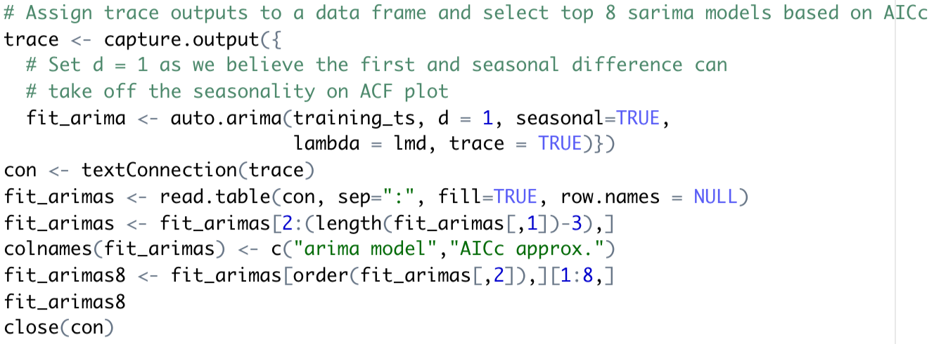
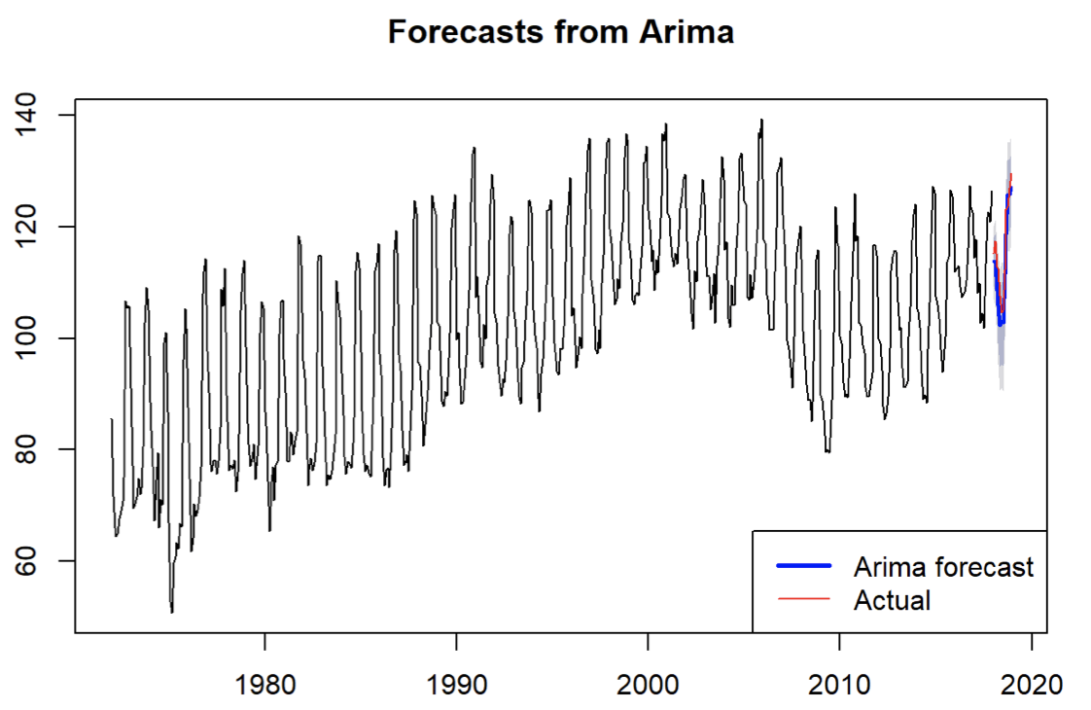
Arima Model (2,1,2)(0,1,2)[12]
ARIMA
auto.arima( ) function to find top 8 ARIMA models with lowest AICc
d is set to 1 to ensure non-seasonal differencing applied
Residuals resemble white noise according to Ljung-Box test
All coefficients are significant
Although AICc is slighter lower for ARIMA(2,1,3)(0,1,2)[12], coefficients for MA1 are not significant from zero, while all coefficients for ARIMA(2,1,2)(0,1,2)[12] are significant from zero
Project Goal and Use Case - Data Intro - Data Exploration -Data Modeling -Result and Evaluation-Conclusion and Future Work
Notes:
auto arima ---set d to 1;
Overall Arima model works well as it passes all tests and has relative small MSE and MAPE

Slide 12
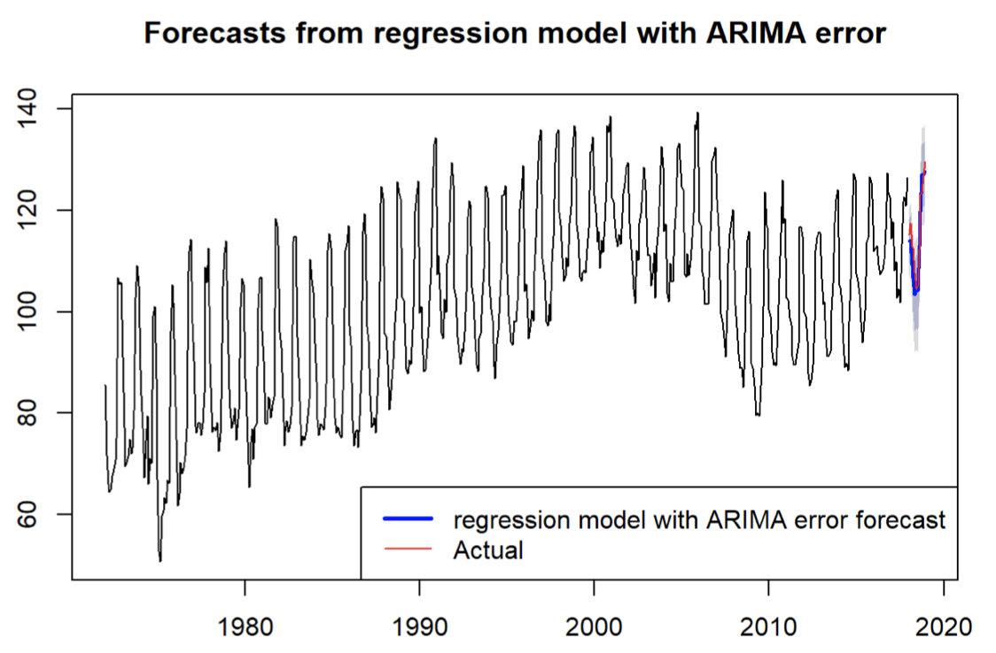
Regression Model With ARIMA Errors
Regression model with ARIMA errors
Personal consumption expenditures is used as an exogenous variable
Ljung-Box test shows that the residuals are white noise
Coeffient x_reg is not significant from 0
Project Goal and Use Case - Data Intro - Data Exploration -Data Modeling -Result and Evaluation-Conclusion and Future Work
Notes:
The xreg coefficient are not significant. This suggests that the exogenous variable does not work well with candy production.

Slide 13
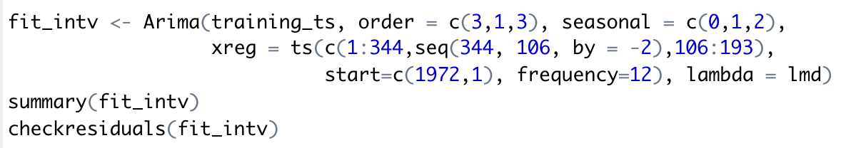
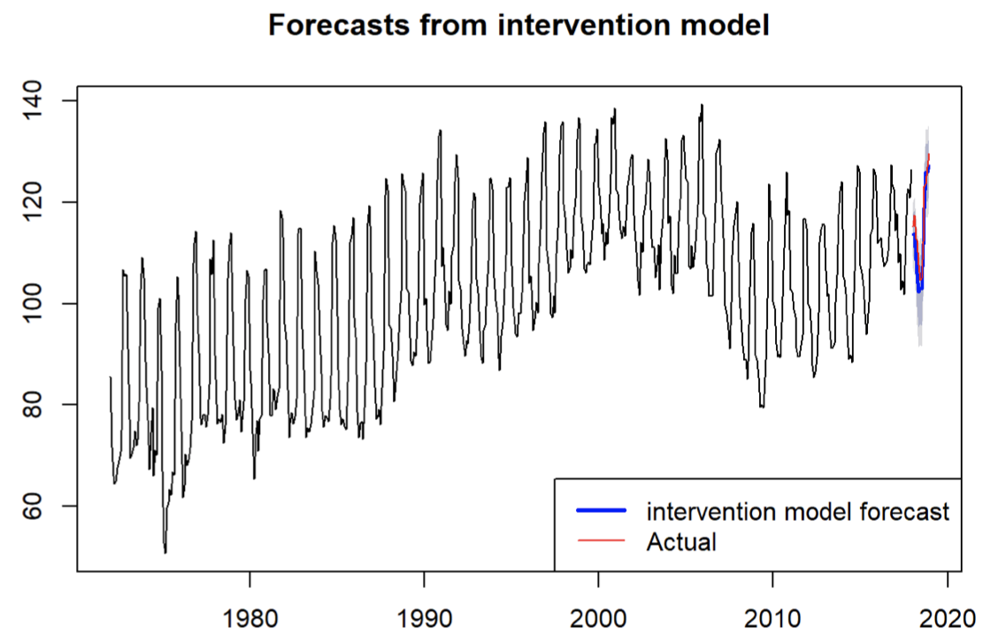
Intervention Model
Intervention Model
Access the effects of intervention (such as holidays, strikes)
Model in a way that match the mean of the original plot
Residuals resemble white noise according to Ljung-Box test
All coefficients are significant from 0
Project Goal and Use Case - Data Intro - Data Exploration -Data Modeling -Result and Evaluation-Conclusion and Future Work

Slide 14
Model Evaluation
Evaluation Metrics
Overall Performance
Box-Ljung test for Residuals (white noise)
Check coefficient significance
MAPE
MSE
AICc (when comparable)
 | White Noise | Coeff Sig | MAPE | MSE | AICc
Arima | YES | YES | 2.69 | 12.90 | 8954.75
ETS | NO | N/A | 4.65 | 35.43 | 11127.92
Linear reg | NO | YES | 6.08 | 64.35 | 9114.18
x_reg | YES | NO | 2.49 | 11.48 | 8956.84
VAR | NO | NO | 4.47 | 37.88 | 5.29
ARFIMA | NO | N/A | 5.11 | 74.69 | 9911.39
Fourier | NO | NO | 4.99 | 45.51 | 9232.13
TBATS | NO | N/A | 6.21 | 67.01 | 5140.64
Intervention | YES | YES | 1.79 | 7.20 | 8945.64
Intervention model is the best model because the residuals are white noise and the coefficients are significant. It also has the lowest MAPE and MSE
Project Goal and Use Case - Data Intro - Data Exploration -Data Modeling -Result and Evaluation-Conclusion and Future Work

Slide 15
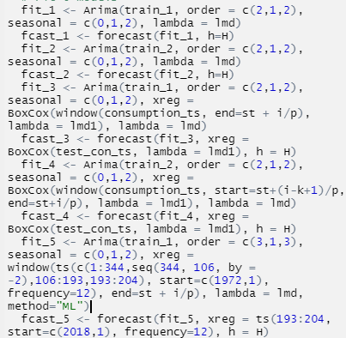
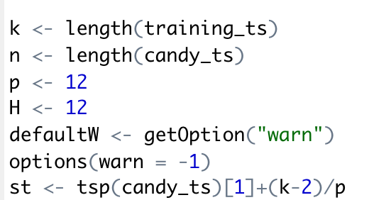
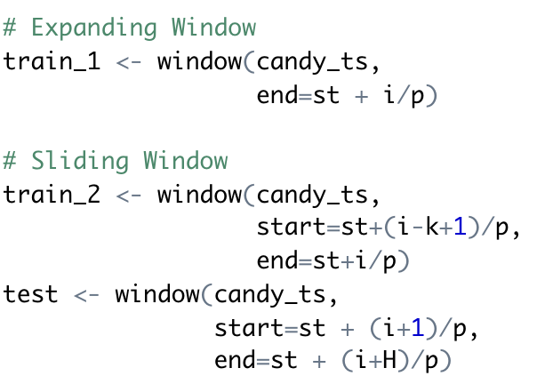
Improve Performance By Cross-validation
Set Parameters
Set Train & Test Dataset
Fit Models (Example)
Set minimum number of observations required to train the model, number of data points and predicting period for the model
Expanding Window: Length= k+i
Sliding Window: keep the training window of fixed length
The training set always consists of k observations
Project Goal and Use Case - Data Intro - Data Exploration -Data Modeling -Result and Evaluation-Conclusion and Future Work

Slide 16
Model Evaluation with Improved Model
 | White Noise | Coeff Sig | MAPE | MSE | AIC
Arima model | YES | YES | 2.69 | 12.90 | 8955.75
ARIMA - Expanding Window | YES | YES | 1.45 | 6.06 | 9014.55
ARIMA - Sliding Window | YES | YES | 1.44 | 5.97 | 8956.42
regression model with ARIMA errors | YES | NO | 2.49 | 11.48 | 8956.84
regression model with ARIMA errors - Expanding Window | YES | NO | 1.38 | 5.64 | 9015.58
regression model with ARIMA errors - Sliding Window | YES | NO | 1.37 | 5.61 | 8957.58
intervention model | YES | YES | 1.78 | 7.20 | 8924.98
Intervention - Expanding Window | YES | YES | 1.16 | 4.19 | 8983.74
Intervention - Sliding Window | YES | YES | 1.14 | 4.16 | 8926.34
Model Performance
Expanding or sliding windows techniques greatly reduced MAPE and MSE
The expanding window increases the AICc for the three models while sliding window keep the values almost the same.
Choose the Right Model
The intervention model with sliding window wins other models because its lowest MAPE and MSE, and AICc.
Project Goal and Use Case - Data Intro - Data Exploration -Data Modeling -Result and Evaluation-Conclusion and Future Work
Notes:
- Intervention model is our best pick based on its AICc value.
- However, if we have slight tolerance on AICc, then the intervention model with sliding window wins other models, with greatly reduced MAPE and MSE but slightly higher AICc.
- The MAPE and MSE are greatly reduced by expanding or sliding windows techniques.
- The expanding window increases the AICc for the three models while sliding window keep the values almost the same.

Slide 17
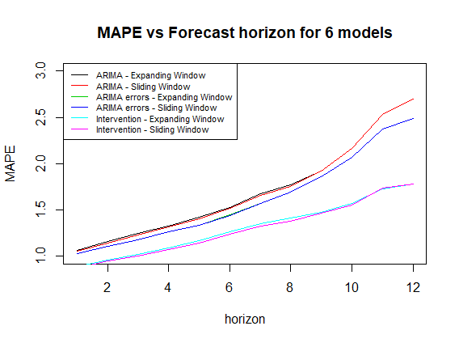
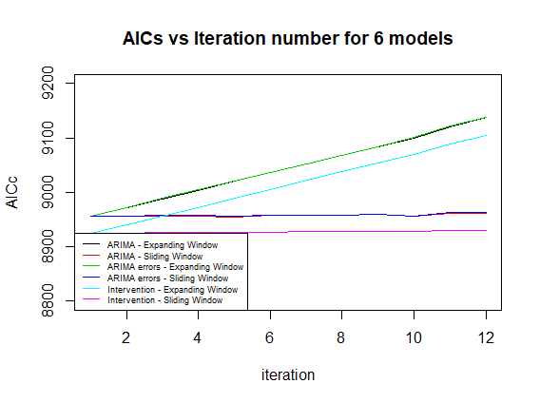
Data Visualization
Project Goal and Use Case - Data Intro - Data Exploration -Data Modeling -Result and Evaluation-Conclusion and Future Work
Notes:
MSE+AICC

Slide 18
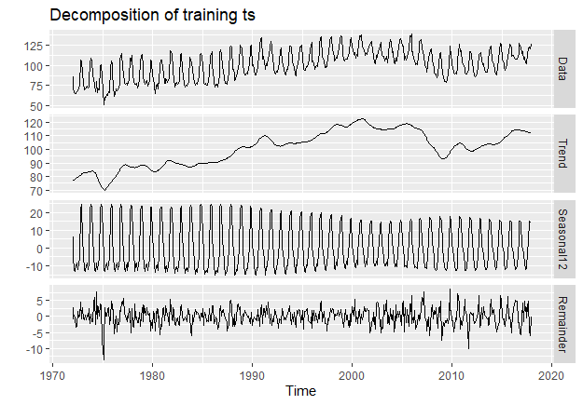
Why intervention model works well?
Analysis
The trend in this dataset is not monotonically upward or downward.
An intervention function that captures these ups and downs is more appropriate.
Project Goal and Use Case - Data Intro - Data Exploration -Data Modeling -Result and Evaluation-Conclusion and Future Work

Slide 19
Address overfitting problem
Detecting overfitting problem
For the final three candidates, all are built on ARIMA model so it makes sense to explore whether overfitting problem exists or not.
We start by decreasing p, then q separately. Among all the simple models, we do not see significant changes in AIC/AICc, BIC and log likelihood.
But we do see significant changes in the coefficients when decreasing p, or q. This suggests that the original models fit well and the overfitting problem does not exist.
The potential overfitting problem is also mitigated by train-test splits and k-fold cross validation.
Project Goal and Use Case - Data Intro - Data Exploration -Data Modeling -Result and Evaluation-Conclusion and Future Work

Slide 20
Model Conclusion
Model Perspective
Adding personal consumption expenditures as an exogeneous variable does work out well in a way to reduce MAPE and MSE but keep AICc value almost the same with ARIMA. However, the coefficient x_reg is not significant which suggests the model is questionable.
Intervention model works very well in this dataset but sometimes fitting such model is more like an art instead of science, as the parameter tuning for the transform function could shift the results a lot.
Hypothetically, we should find a model that satisfies all the conditions and tests: Ljung-Box test, Shapiro-Wilk test, coefficient significance, lowest AICc, lowest MAPE, lowest MSE, etc. In reality, these metrics are rarely met in a single model. Therefore, we have to compromise and decide priority on the metrics such that the model satisfying our compromised metrics wins.
Project Goal and Use Case - Data Intro - Data Exploration -Data Modeling -Result and Evaluation- Conclusion and Future Work
Notes:
The models have better performance is the one with significant coefficiet

Slide 21

Application and Limitation
01.
Application
Our result could be useful to candy or any other candy related company and wholesaler.
02.
Limitation
In this dataset, we only use personal consumption expenditures as an exogeneous variable but apparently there are other variables that could impact the candy production. For example, we could include the monthly obesity or BMI rate and see how they can improve the model. However, finding the monthly data for these variables are often difficult.
Project Goal and Use Case - Data Intro - Data Exploration -Data Modeling -Result and Evaluation- Conclusion and Future Work

Slide 22
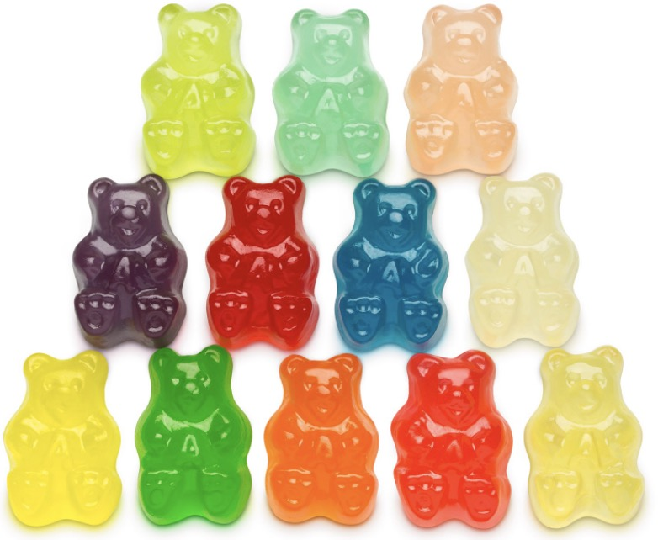
Further Improvement
Model Perspective
Try more complicated models, such as RNN or state space models
Bootstrapping
Ensemble models
Sensitivity/Uncertainty analysis
Optimization method
Shorten the time frame of dataset (long time frame, performance
will deteriorate)
Include other exogeneous variables that are related to
candy production
Data Perspective
Project Goal and Use Case - Data Intro - Data Exploration -Data Modeling -Result and Evaluation- Conclusion and Future Work
Notes:
The longer we forcast ahead, the more unaccurate our model is.

